Slide 1


Machine Learning
AIC-3072
(3 CrH = 2 Theory 1 Lab)
Week No. 01
Dr. Muhammad Adeel
Department of Computer Science
National Textile University
dr.muhammad.adeel.ntu@gmail.com

Slide 2
Week 1: Machine Learning

Slide 3


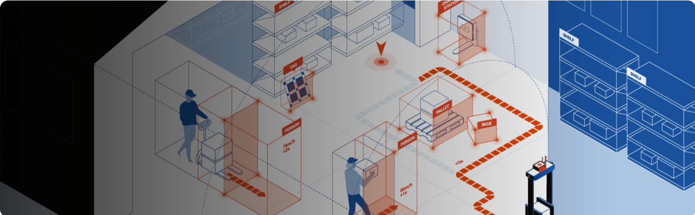

Agenda – What will you Learn Today?
Introduction to the Course
Machine Learning Intro
3
Machine Learning, AIC-3072

Slide 4
Rules and Regulations to get Success
Pray 5 times a day if you are Muslim and with Jamaat in Masjid if you are male.
Don’t tell a lie.
Don’t cheat
Massage the feet of your beloved parents daily with their permission.
Confirm you have 2 pens/pencils, ring binding register, desktop computer/laptop (fully charged) and USB before one starting of the class
Don’t be late. Join class 2 or 3 minutes before.
4

Slide 5
Rules and Regulations to get Success …
Must prepare slides before every lecture and study the same topic from book at least once (or twice is good).
Revise all prepared previous slides at week-end.
Don’t wait for due date and time for your assignments, rather complete and submit them well before and start working on assignments from the day when you will be assigned.
Be 100% regular because lectures are linked like a chain, if one part of the chain is broken, then it is not called chain.
Daily read the above rules and tick the followed rule by putting date
5
Software Engineering Fundamentals, COC-2072

Slide 6
Course Information
Title of Course: Machine Learning
Theory Credits: 2
Lab Credits: 1

Slide 7
Theory Assessment
Mid Exam (30%)
Final Exam (40%)
Sessional (30%)
4 Quizzes
2 Assignments
1 Project

Slide 8
Lab Assessment
14 Lab Assessment(70%)
Submission
Attendance
Assessment
Final Project

Slide 9
Objectives of Course
The aim of this course is to:
a) Present the basic machine learning concepts;
b) Present a range of machine learning algorithms along with their strengths and weaknesses;
c) Apply machine learning algorithms to solve problems of moderate complexity

Slide 10
Course Learning Outcomes
CLO-1: Describe basic machine learning concepts, theories and applications. C1 (Knowledge)
CLO-2: Apply supervised learning techniques to solve classification problems of moderate complexity. C3 (Apply)
CLO-3: Apply unsupervised learning techniques to solve clustering problems of moderate complexity C3 (Apply)
CLO-4: Apply reinforcement learning algorithms to environments with complex dynamics. C3 (Apply)
CLO-5: Develop a reasonable size project using suitable machine learning technique C6 (Create)

Slide 11
Weekly Agenda…
Machine learning Defined
Types of Machine Learning
Dataset Types
Machine Learning Challenges

Slide 12

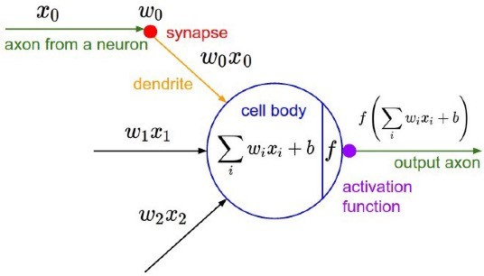
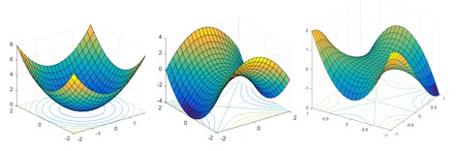
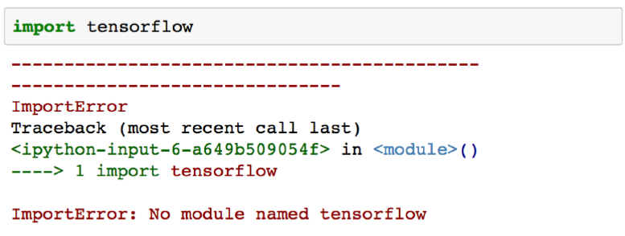
Machine Learning
Public perception of ML
Reality

Slide 13
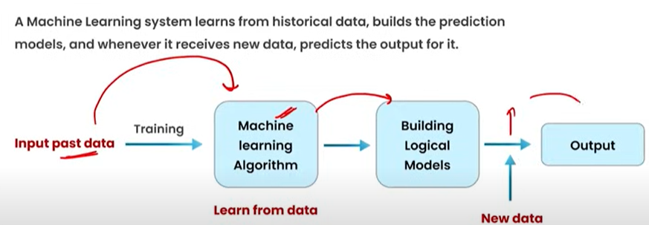
Machine Learning

Slide 14
What is machine learning?
Machine Learning (ML) is a branch of Artificial Intelligence (AI) that focuses on building systems that can learn from data and improve their performance without being explicitly programmed for every rule.
In simple words:
Instead of giving the computer exact step-by-step instructions, you give it data (examples), and it finds patterns or rules on its own to make predictions or decisions.

Slide 15
What is machine learning?
Example
Traditional programming: If exam_score ≥ 50 → Pass, otherwise Fail (you write the rule).
Machine learning: Give the computer many examples:
Hours studied = 10 → Pass
Hours studied = 2 → Fail
Hours studied = 7 → Pass The computer learns the hidden rule: "More study hours → Higher chance of Pass."
One-line definition:
Machine Learning is the study, design, and use of algorithms that learn patterns from data (input–output pairs) and make predictions or decisions.

Slide 16
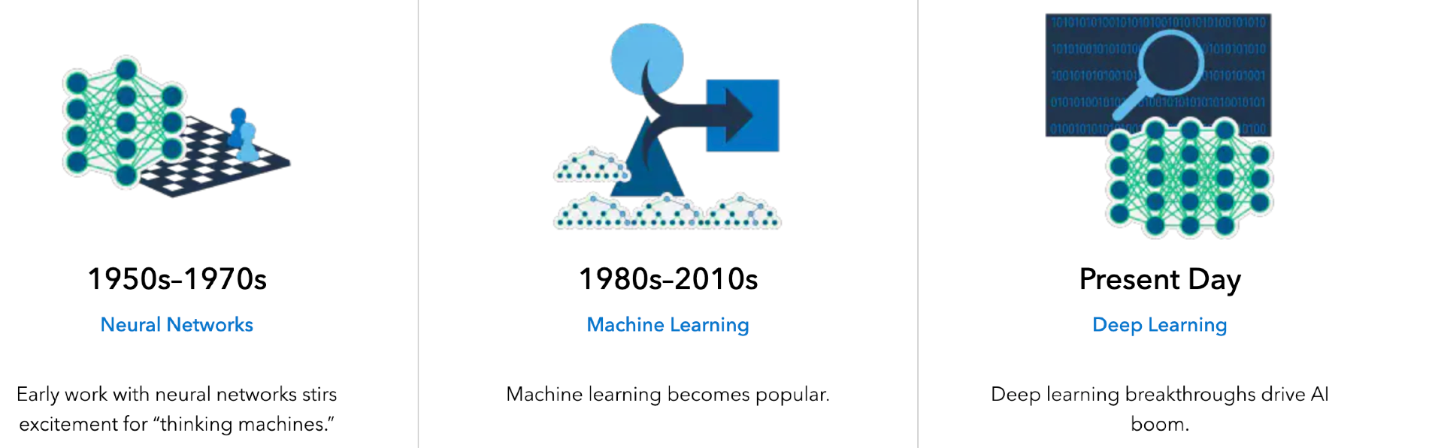
A little bit history
Alan Turing gave quite possibly the earliest public lecture on this topic in 1947:
“What we want is a machine that can learn from experience”

Slide 17
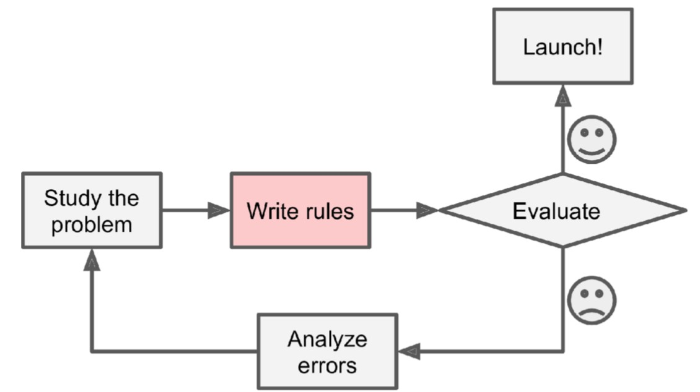
Why should we use machine learning?
Let’s say we want to design a spam filtering system
One approach is to use traditional programming techniques
Look for words or phrases such as: credit card, free, bank information, “C U”
Write a detection algorithm for each of the patterns
Test your program and improve it

Slide 18
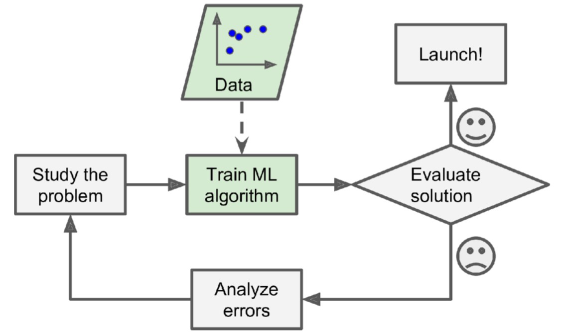
Why use machine learning?
A spam filter based on machine learning automatically learns which words and phrases are good predictors
Possible benefits: simpler, easier to maintain, and more accurate
The examples that the system uses are called the training set
We should also think of a performance measure

Slide 19
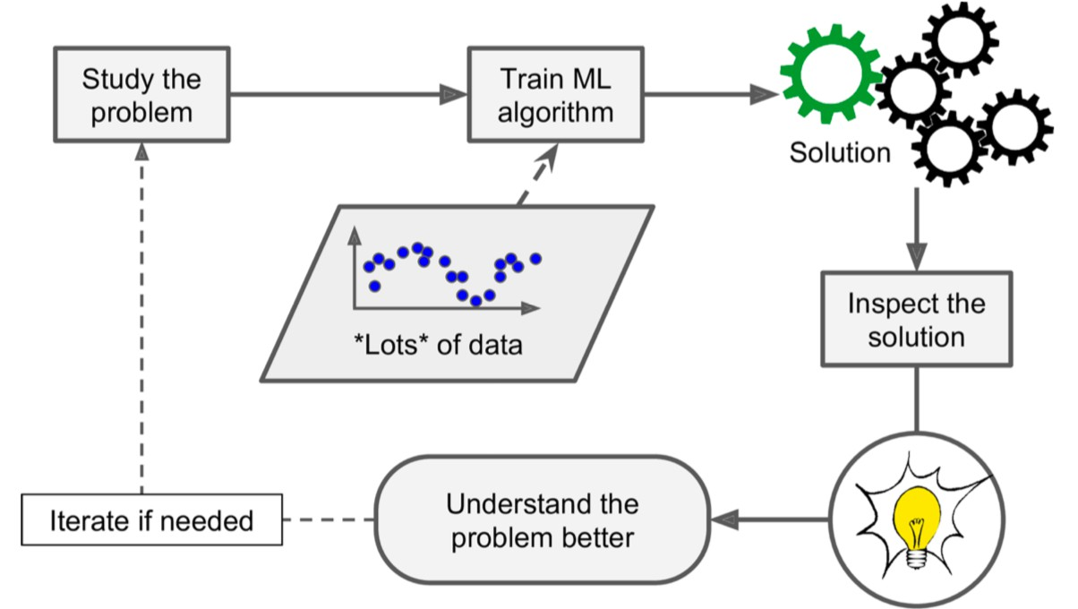
Beyond prediction
Machine learning can help human learn and discover patterns from large amounts of data that are not immediately apparent
This is usually called data mining

Slide 20
A few applications of machine learning
Autonomous navigation systems
use sensors, cameras, GPS, and algorithms
Examples
Self-driving cars → Navigate roads, avoid traffic, follow signals.
Autonomous drones → Fly to a target location, avoid trees/buildings.
Robotic vacuum cleaners → Map a room, avoid furniture, and clean efficiently.

Slide 21
A few applications of machine learning
Analyzing images of items on a product line
How it works
Image capture → A camera takes pictures of each item.
Image processing → The system identifies shapes, colors, sizes, or defects.
Decision-making → Based on the analysis:
Good item → Pass
Defective item → Reject
Examples
Electronics → Checking if all components are correctly placed on a circuit board.
Food industry → Detecting rotten fruits or misshaped biscuits.
Textiles → Spotting defects in fabric (holes, stains).
Bottling/packaging → Ensuring caps are sealed and labels are aligned.

Slide 22
A few applications of machine learning
Analyzing medical images help doctors detect, classify, or measure conditions from medical scans.
How it works
Image capture → Medical imaging devices create scans, e.g.,
X-rays, CT scans, MRI, Ultrasound
Preprocessing → The image is enhanced (noise removed, contrast adjusted).
Analysis / AI model → Algorithms detect patterns such as tumors, fractures, infections, or abnormalities.
Decision support → Results are given to doctors:
Highlight suspicious regions.
Measure size, shape, or growth of disease. And Suggest diagnosis probabilities.

Slide 23
A few applications of machine learning
Analyzing medical images help doctors detect, classify, or measure conditions from medical scans.
Examples
Detecting cancer tumors in mammograms or CT scans.
Identifying brain diseases like Alzheimer’s from MRI scans.
Spotting COVID-19 infection in chest X-rays.
Measuring bone fractures from X-rays.

Slide 24
A few applications of machine learning
Automatically flagging offensive comments on social media platforms
Forecasting revenue
Creating a recommendation engine
Speech recognition (like Siri and Alexa)
And many more!

Slide 25
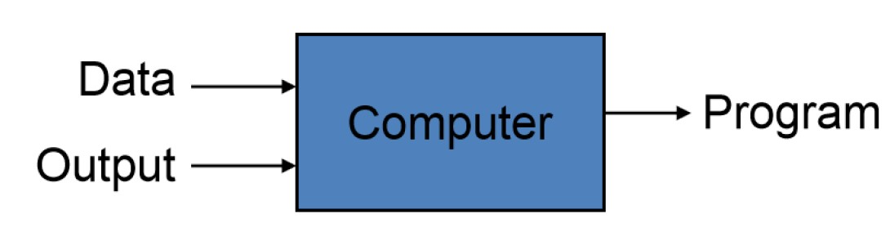
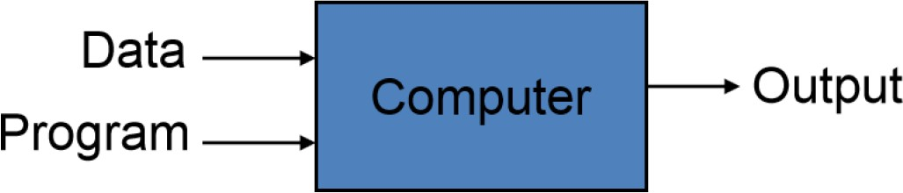
Machine Learning Overview
What is Machine Learning?
Automating the process of automation
Getting computers to program themselves
Traditional Programming
Machine Learning
Given examples (training data), make a machine learn system behavior or discover patterns

Slide 26
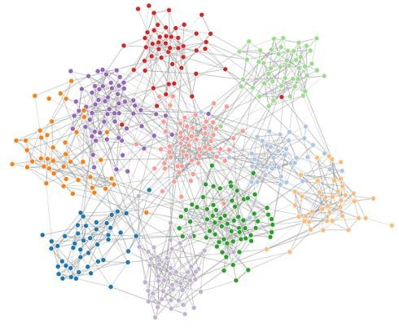


Machine Learning: Overview
What is Machine Learning?
- Study, Design and Analysis of algorithms that improve their performance at some task
(Algorithms improve the performance of the algorithms themselves in doing a task.)
Model
f (x)
Algorithm
Data

Slide 27
Learning From Examples
Factored representation (Examples)
a vector of features/attributes values (input)
and outputs that can be either a continuous numerical value or a discrete value. (output)
INDUCTIVE LEARNING :a general function or rule from specific examples (input–output) pairs is called inductive learning.

Slide 28
Learning From Examples
Factored Representation
Means: we describe something using a set of features (attributes) written as a list or vector.
Input: a collection of values (features).
Output: can be
a number (continuous value)
or a category/label (discrete value).

Slide 29
Learning From Examples
Example: Suppose we want to predict whether a student will pass or fail.
Input features (vector):
Hours studied = 5
Attendance % = 90
Sleep hours = 7 → This is the input vector of attributes.
Output:
Continuous: predicted exam score = 78
Discrete: result = “Pass”

Slide 30
Learning From Examples
Inductive Learning
Means: learning a general rule or function from many specific examples (input–output pairs).
It’s like: see enough examples, then guess the hidden rule.
Example:
Input–Output pairs:
(Hours studied = 2 → Score = 40)
(Hours studied = 5 → Score = 70)
(Hours studied = 8 → Score = 90)
Inductive learning finds the general rule:
“More study hours usually lead to a higher score.”

Slide 31
Inductive Learning: From examples (x1..x12), learn a general rule Example: More hours studied → Higher score → Pass
 | Input features (vector) |  |  | Output
 |  |  |  | Continuous | Discrete
 | Factored Representation
Examples | Hours Studied | Attendance % | Sleep Hours | Score | Target
x1 | 6 | 74 | 5 | 58 | y1 = Pass
x2 | 1 | 62 | 6 | 13 | y2 = Fail
x3 | 4 | 51 | 5 | 36 | y3 = Fail
x4 | 4 | 88 | 8 | 38 | y4 = Fail
x5 | 8 | 89 | 5 | 78 | y5 = Pass
x6 | 4 | 73 | 8 | 38 | y6 = Fail
x7 | 6 | 96 | 6 | 62 | y7 = Pass
x8 | 3 | 74 | 7 | 25 | y8 = Fail
x9 | 5 | 67 | 8 | 46 | y9 = Fail
x10 | 8 | 87 | 8 | 84 | y10 = Pass
x11 | 7 | 75 | 5 | 74 | y11 = Pass
x12 | 9 | 63 | 7 | 85 | y12 = Pass

Slide 32
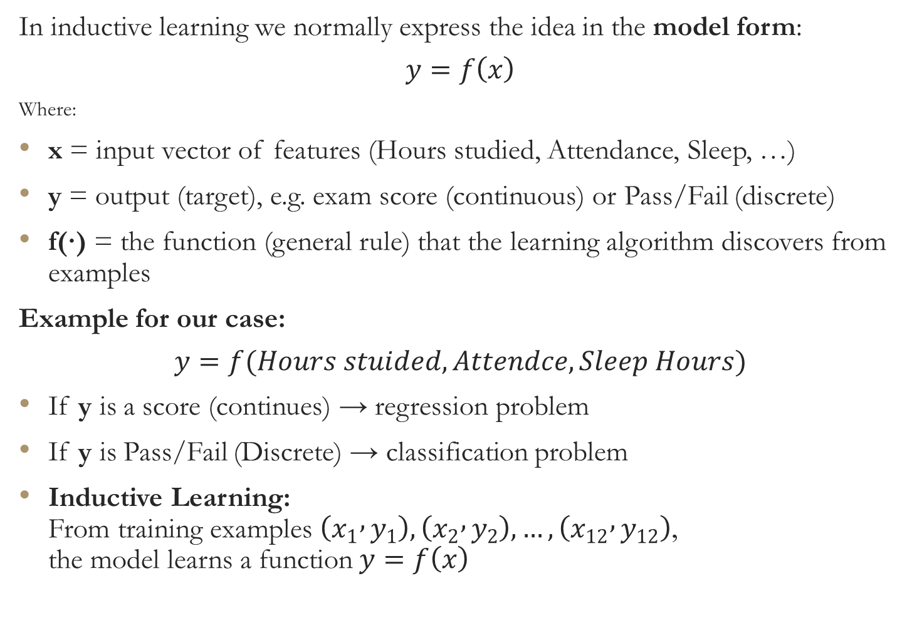
Learning From Examples
In inductive learning we normally express the idea in the model form:
$$y=f\left(x\right)$$
Where:
x = input vector of features (Hours studied, Attendance, Sleep, …)
y = output (target), e.g. exam score (continuous) or Pass/Fail (discrete)
f(·) = the function (general rule) that the learning algorithm discovers from examples
Example for our case:
$$y=f(Hours stuided, Attendce, Sleep Hours)$$
If y is a score (continues) → regression problem
If y is Pass/Fail (Discrete) → classification problem
Inductive Learning: From training examples $\left(x_{1} , y_{1}\right),\left(x_{2} , y_{2}\right),…,\left(x_{12} , y_{12}\right)$, the model learns a function$y=f\left(x\right)$

Slide 33
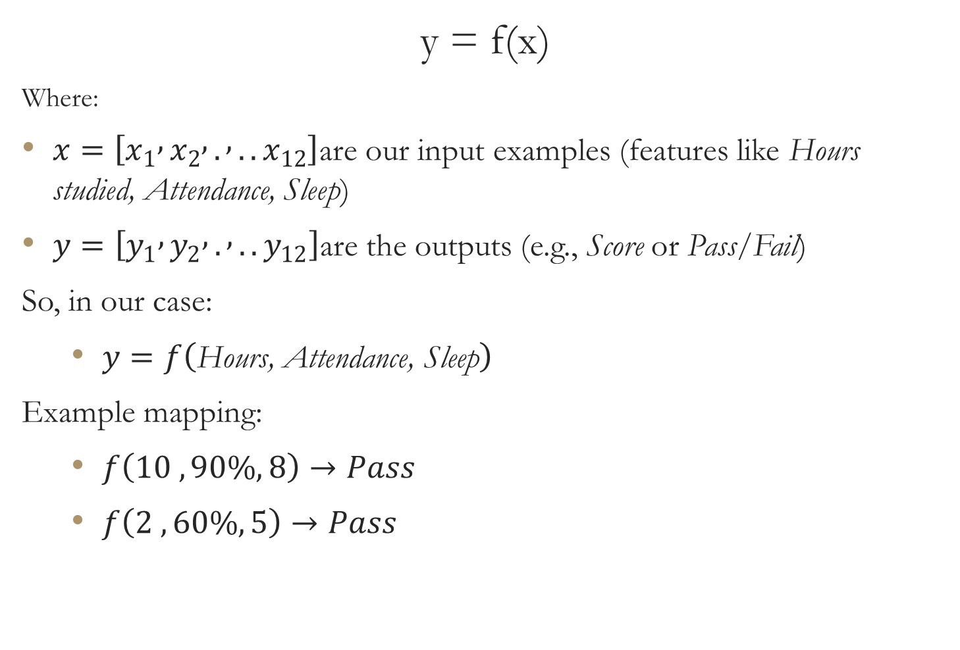
Learning From Examples
y = f(x)
Where:
$x=\left[x_{1} , x_{2} , . , ..x_{12}\right]$are our input examples (features like Hours studied, Attendance, Sleep)
$y=\left[y_{1} , y_{2} , . , ..y_{12}\right]$are the outputs (e.g., Score or Pass/Fail)
So, in our case:
$y=f\left(\text{Hours}\text{, }\text{Attendance}\text{, }\text{Sleep}\right)$
Example mapping:
$f\left(10 ,90\%, 8\right)→Pass$
$f\left(2 ,60\%, 5\right)→Pass$

Slide 34
Machine Learning Types
Supervised learning
Classification (Discrete)
Numeric Prediction (Continuous)
Unsupervised learning
Clustering
Principle Component Analysis
Semi-supervised learning
Reinforcement learning
Machine Learning
Binary Class e.g., Pass/Fail, Yes/No
Multiple Class e.g., Cat/Dog/Horse
Simple Regression
Multiple Regression

Slide 35

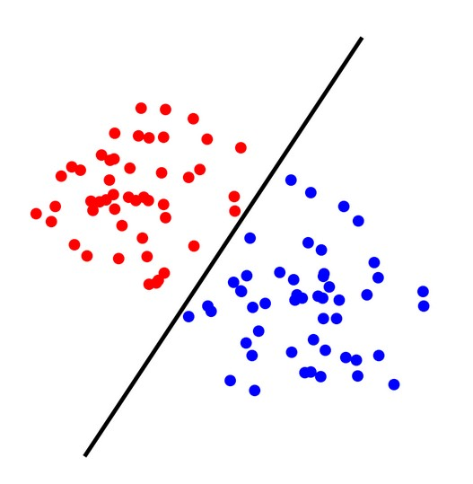
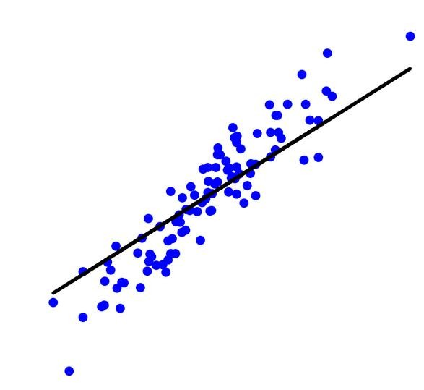
Nature of ML Problems
Supervised Learning: The learning algorithm would receive a set of inputs along with the corresponding correct outputs to train a model
Training Data
All labeled data
Model
Prediction
Classification: Discrete Prediction
Regression: Quantitative Prediction on a continuous scale
Given a data sample, predict its class
Given a data sample, predict a numerical value

Slide 36

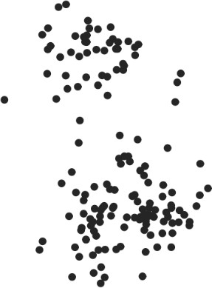
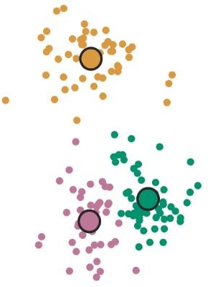
Nature of ML Problems
Unsupervised Learning: The learning algorithm would receive unlabeled raw data to train a model and to find patterns in the data
Training Data
All unlabeled data
Model
Clustering

Slide 37

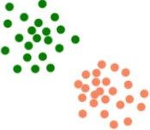
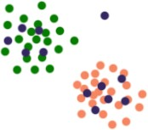
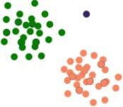
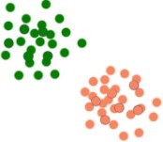
Nature of ML Problems
Semi-supervised Learning: The learning algorithm receives labeled and unlabeled raw data to train a model Main objective is to efficiently accommodate the unlabeled data
Training Data
Labeled
+
unlabeled Data
Data Modeling and Augmentation
Model
Anomaly
-> ignore it
Use labeled data to build a model
Place unlabeled data with model
Use the model to label the unlabeled data
Fit the model again with the combined data

Slide 38
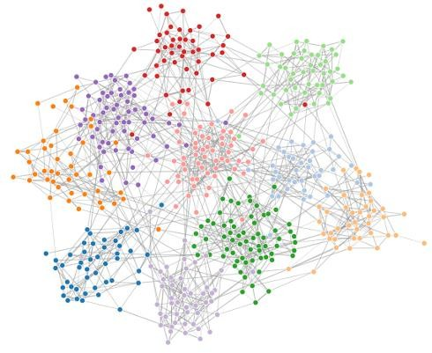
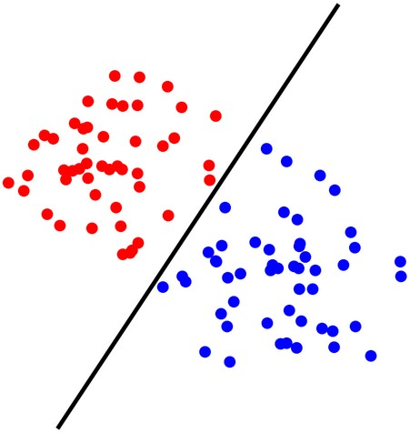
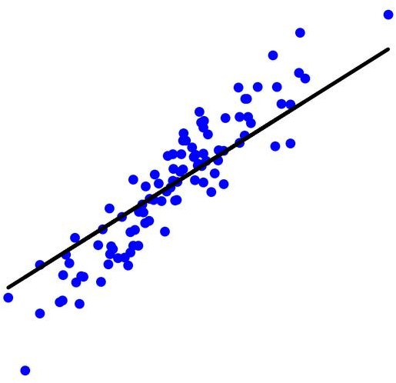


Machine Learning: Overview
Typical Flow
Problem Nature Identification
Training Data Collection
f (x)
Model Training
Model Deployment
Model Validation

Slide 39
Dataset Types
In Machine Learning, datasets are usually categorized based on their nature and purpose. Here’s a clear breakdown:
Types of Datasets in Machine Learning
1. Structured Dataset
Data is organized in rows & columns (like a table).
Easy to store in databases and spreadsheets.
Examples:
Student records: (Name, Age, GPA, Attendance)
Banking transactions: (Account ID, Amount, Date, Type)

Slide 40
Dataset Types
2. Unstructured Dataset
No fixed format or organization.
Often text, images, audio, or video.
Examples:
Social media posts (text + emojis).
Medical images (X-rays, MRI scans).
Recorded customer service calls.

Slide 41
Dataset Types
3. Semi-Structured Dataset
Not fully tabular, but still has some structure (tags, hierarchies).
Often stored in JSON, XML, or NoSQL databases.
Examples:
Web data (HTML/XML pages).
Sensor logs from IoT devices.
Email (structured headers + unstructured body text).

Slide 42
Dataset Types
4. Labeled Dataset (Supervised Learning)
Each data point has input (features) + output (label).
Used for classification & regression.
Examples:
Images of cats and dogs with labels “cat” or “dog”.
Student study hours → exam result (Pass/Fail).

Slide 43
Dataset Types
5. Unlabeled Dataset (Unsupervised Learning)
Only input features are available, no output labels.
Used for clustering, dimensionality reduction, anomaly detection.
Examples:
Customer purchase histories without categories.
Genetic data without disease labels.

Slide 44
Dataset Types
6. Time-Series Dataset
Data collected over time, sequential in nature.
Each record depends on past values.
Examples:
Stock market prices (daily closing values).
Weather records (temperature per hour/day).
Heart rate monitor readings.

Slide 45
Dataset Types
7. Transactional Dataset
Data from transactions or events, often large-scale.
Common in market basket analysis.
Examples:
Supermarket sales: (Item1, Item2, …)
Online shopping clickstream logs.

Slide 46
Dataset Types
8. Image, Audio, Video Datasets (Specialized)
Used in computer vision, speech recognition, NLP.
Examples:
ImageNet → millions of labeled images.
LibriSpeech → audio dataset for speech recognition.
YouTube-8M → video dataset for classification.
In short:
Structured, Unstructured, Semi-Structured → Based on format.
Labeled, Unlabeled → Based on learning type.
Time-Series, Transactional, Multimedia → Based on domain/application.

Slide 47
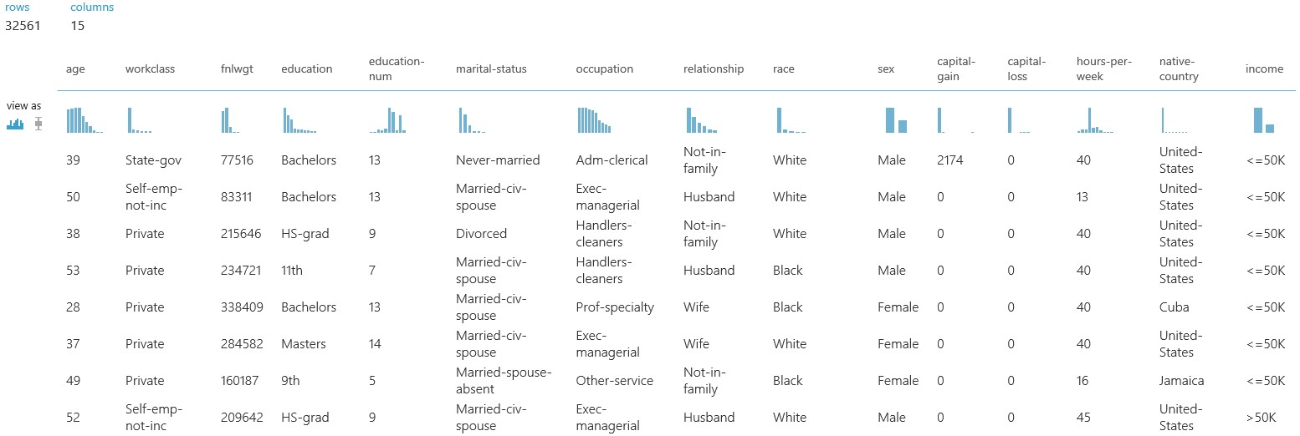
Machine Learning: Overview
Dataset Types
Tabulated Data
Each column is a feature and adds one dimension to the data
Number of columns define total number of features and hence data dimensionality
Ideally, these columns should contain different information -> uncorrelated

Slide 48
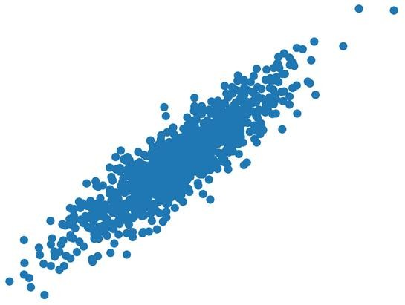
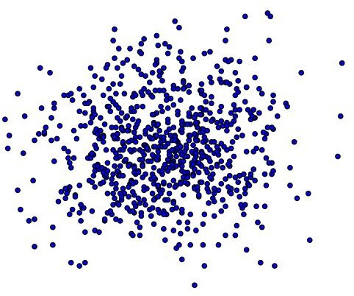


Machine Learning: Overview
Dataset Types
Feature 2
Feature 2
Feature 1
Features are correlated
Feature 1
Features are uncorrelated
Dimensionality Reduction: Find all those dimensions (features) which carry very less information and discard them

Slide 49
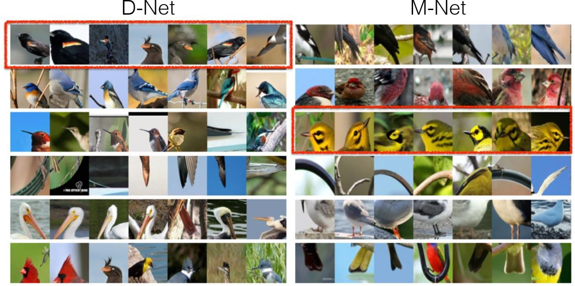
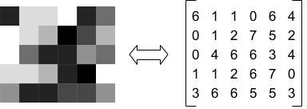
Machine Learning: Overview
Dataset Types
Images
Each image (greyscale) is a 2D data which can be represented as a matrix

Slide 50
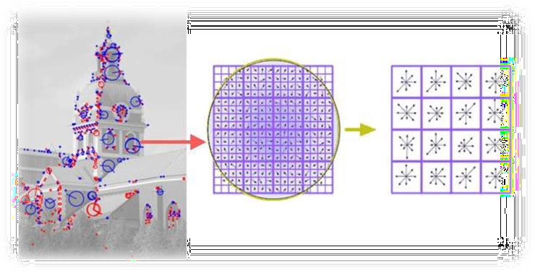
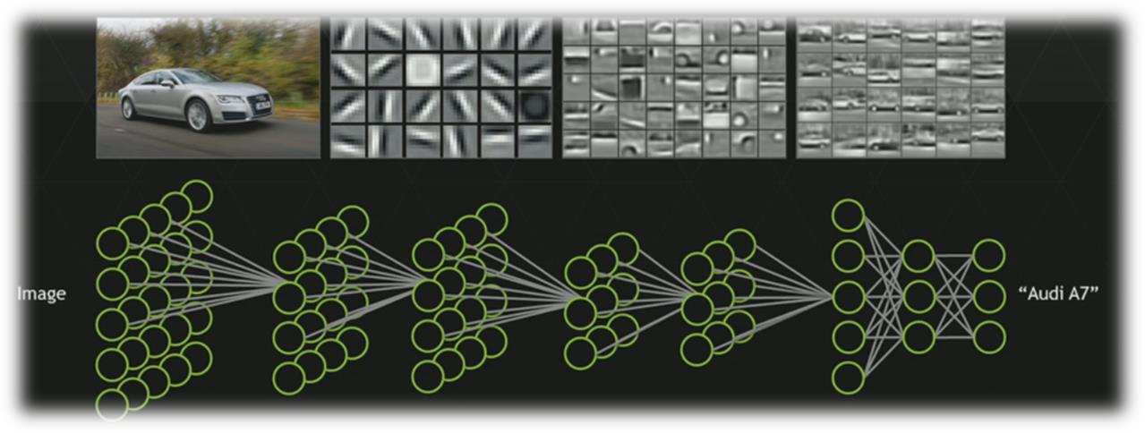
Image Descriptors:
Manually extract features
Deep Learning:
Let machine learning extract most important features
Speeded-Up Robust Features (SURF)
Binary Robust Independent Elementary Features (BRIEF)
Oriented FAST and Rotated BRIEF (ORB)
Scale-Invariant Feature Transform (SIFT)
Histogram of Oriented Gradients (HOG)
HAAR features
etc.
Neural Networks such as Convolutional Neural Networks (CNN) take raw images as input and first process it inside multiple layers to get best features called intrinsic dimension of the data

Slide 51
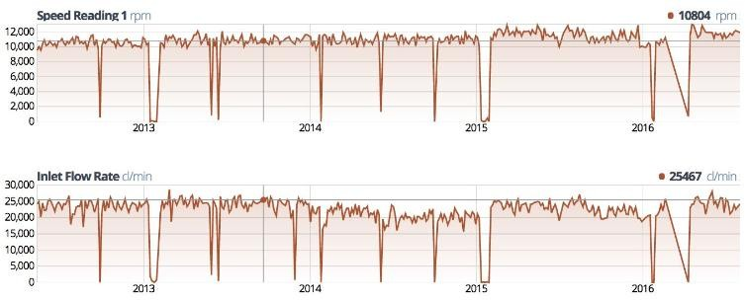
Machine Learning: Overview
Data Types
Time Series
Much difficult to deal with
Enormous Size
Cumbersome Labeling
Not so standard feature extraction strategies as in case of images. (Direct modeling of time series is preferred)

Slide 52
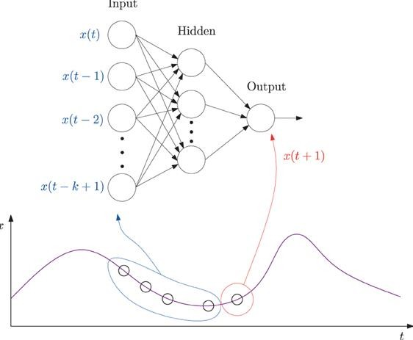
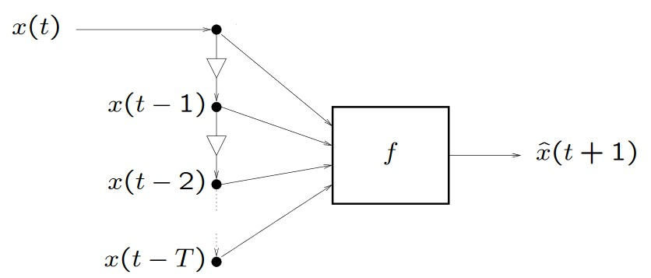
Machine Learning:Let machine learning handle the task !
Time series Models:Manually model it !
Exponential Smoothing (ETS)
Autoregressive Integrated Moving Average (ARIMA) models
Linear regression
Generalized Autoregressive Conditional Heteroskedasticity (GARCH)
Bayesian Models
Vector auto-regression (VAR) models
etc.
Neural Networks such as Convolutional Neural Networks (CNN) take raw waveforms as input and first process it inside multiple layers to get best predictive model for it

Slide 53
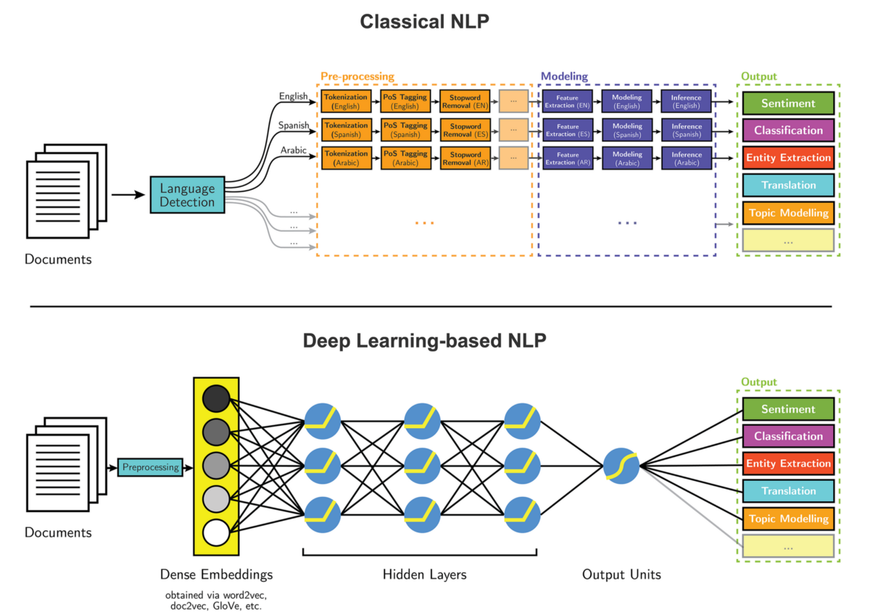

Slide 54

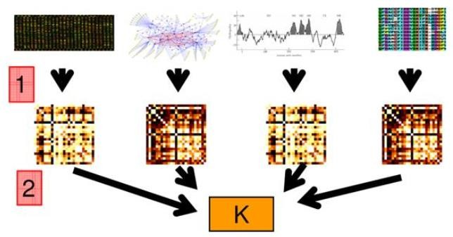
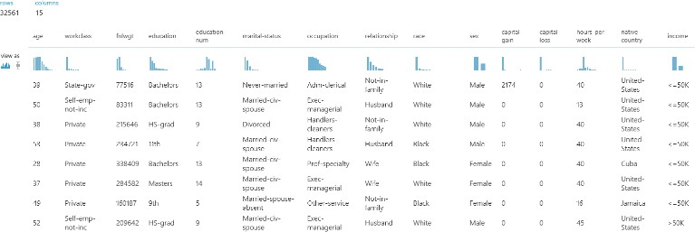
Machine Learning: Overview
Data Types
Heterogeneous data
Multimodal Machine Learning !
+
+

Slide 55
Inductive Learning Process

Slide 56
Inductive Machine Learning Process …
Preparation of Training Data
Learning Scheme OR
Learning Algorithm
Trained Model
Testing and Evaluation
Test Data
Deploy Trained & Tested Model in Domain

Slide 57
Deployed Model…
New/ Unknown Instance
ML Model
Result/ Prediction

Slide 58
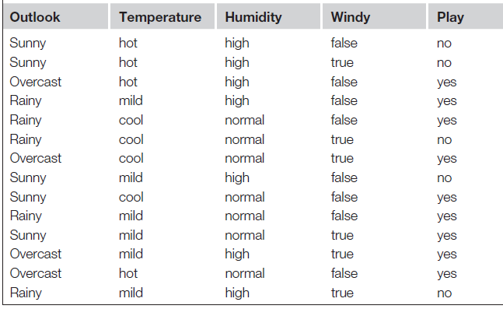
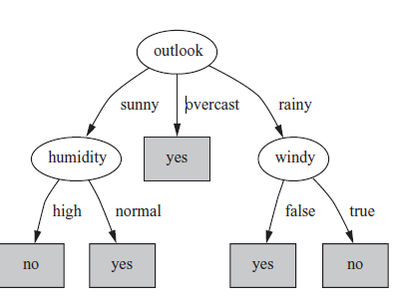
Machine Learning Process
Learning Scheme OR
Learning Algorithm

Slide 59
Attributes
Attribute (or dimensions, features, variables): a data field, representing a characteristic or feature of a data object.
E.g., customer _ID, name, address
Types:
Nominal
Binary
Numeric: (Discrete, Continuous)
Interval-scaled
Ratio-scaled

Slide 60
Attribute Types
Nominal: categories, states, or “names of things”
Hair_color = {auburn, black, blond, brown, grey, red, white}
marital status, occupation, ID numbers, zip codes
Binary
Nominal attribute with only 2 states (0 and 1)
Symmetric binary: both outcomes equally important
e.g., gender
Asymmetric binary: outcomes not equally important.
e.g., medical test (positive vs. negative)
Convention: assign 1 to most important outcome (e.g., HIV positive)
Ordinal
Values have a meaningful order (ranking) but magnitude between successive values is not known.
Size = {small, medium, large}, grades, army rankings

Slide 61
Numeric Attribute Types
Quantity (integer or real-valued)
Interval
Measured on a scale of equal-sized units
Values have order
E.g., temperature in C˚or F˚, calendar dates
No true zero-point
Intangible
We can add and subtract, but we cannot multiply, divide or calculate ratios.
Ratio
Inherent zero-point
tangible
We can speak of values as being an order of magnitude larger than the unit of measurement (10 K˚ is twice as high as 5 K˚).
e.g., temperature in Kelvin, length, counts, monetary quantities

Slide 62
General Characteristics of Data Sets
Dimensionality
The dimensionality of a data set is the number of attributes that the objects in the data set have.
In a particular data set if there are high number of attributes, then it can become difficult to analyze such a data set. This problem is referred as Curse of Dimensionality.
Sparsity
For some data sets, most attributes of an object have values of 0; in many cases fewer than 1% of the entries are non-zero. Such a data is called sparse data or it can be said that the data set has Sparsity.
Resolution
Resolution is the smallest change that can be measured.
Finer resolution reduces rounding errors. However, resolution that is too coarse may add rounding errors.

Slide 63
Supervised Machine Learning

Slide 64
Supervised Machine Learning Types
Types Supervised Machine Learning
Classification
Regression \ Numeric Prediction
Also Known as Predictive Learning

Slide 65
Classification Learning
Supervised Learning
Prediction Belongs to one of distinct\Discrete class
If Prediction Consists of two Classes also known as Binary Prediction
Measure success on fresh data for which class labels are known (test data)

Slide 66
Classification Learning
Classification
Association
Regression \ Numeric Prediction
Class Attribute

Slide 67
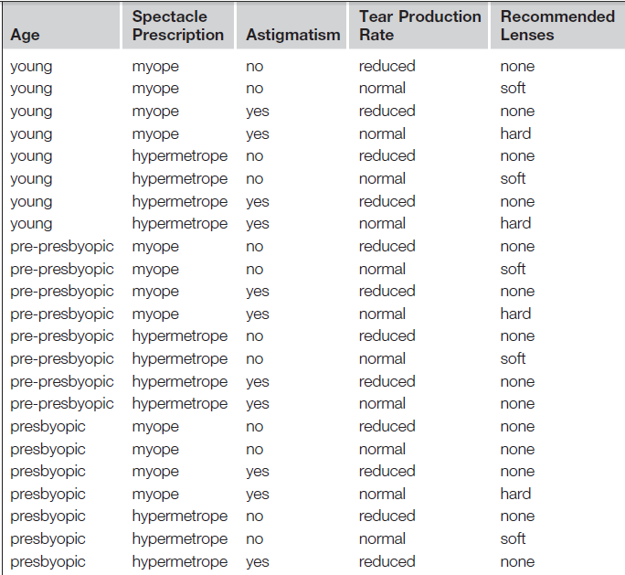
Contact Lens Problem (Classification )
Class Attribute

Slide 68
Classification Algorithms
There are many algorithms for classification. Some of the famous are following:
Decision trees
Naive Bayes classifier
Linear Regression
Logistic regre0ssion
Neural networks
Perceptron
Multi Layer Neural Networks
Support vector machines (SVM)
Quadratic classifiers
Instance Based Learning
k-nearest neighbor

Slide 69

Regression \ Numeric Prediction
Variant of classification learning where “class” is numeric (also called “regression”)
Learning is supervised
Scheme is being provided with target value
Measure success on test data
Classification
Association
Regression \ Numeric Prediction

Slide 70
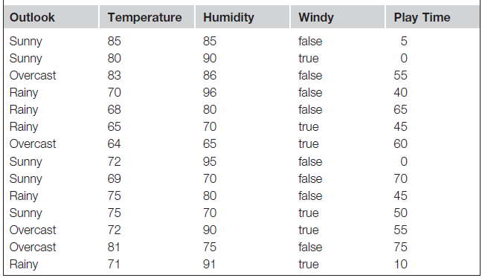
Numeric Prediction

Slide 71
Association Learning
Can be applied if no class is specified and any kind of structure is considered “interesting”
Difference to classification learning:
Can predict any attribute’s value, not just the class, and more than one attribute’s value at a time
Hence: far more association rules than classification rules
Association rules usually involve only nonnumeric attributes

Slide 72
Contact Lens Problem (Association )

Slide 73
Preparation of Training Data…
Preparation of Training Data
Learning Scheme OR
Learning Algorithm
Machine Learning OR Trained Model
Testing and Evaluation

Slide 74
Preparation of Training Data

Slide 75
Components Training Data
Instances/Examples
Individual, independent examples of a concept
Attributes/Features
measuring aspects of an instance
We will focus on nominal and numeric ones

Slide 76
Training Data

Slide 77
Input in form of table
Set of instances/dataset
Represented as a single relation/flat file
Rather restricted form of input
No relationships between objects
Most common form in practical Machine Learning

Slide 78
Attributes OR Features
Each example/Instance is characterized on the basis of fixed, predefined set of features/attributes
Instances may have more features?
Features may depends on each other
Selection of features
Contribution of a feature

Slide 79
Feature Types
Features can be classified on the basis of their values
Nominal
Values are distinct Symbols
Numeric
Either real or integer valued

Slide 80
Feature Types

